Slide 1
Winter is Coming: Q3 Review and Q4 Outlook
^{Hosted by Yusuf Abugideiri}

Slide 2
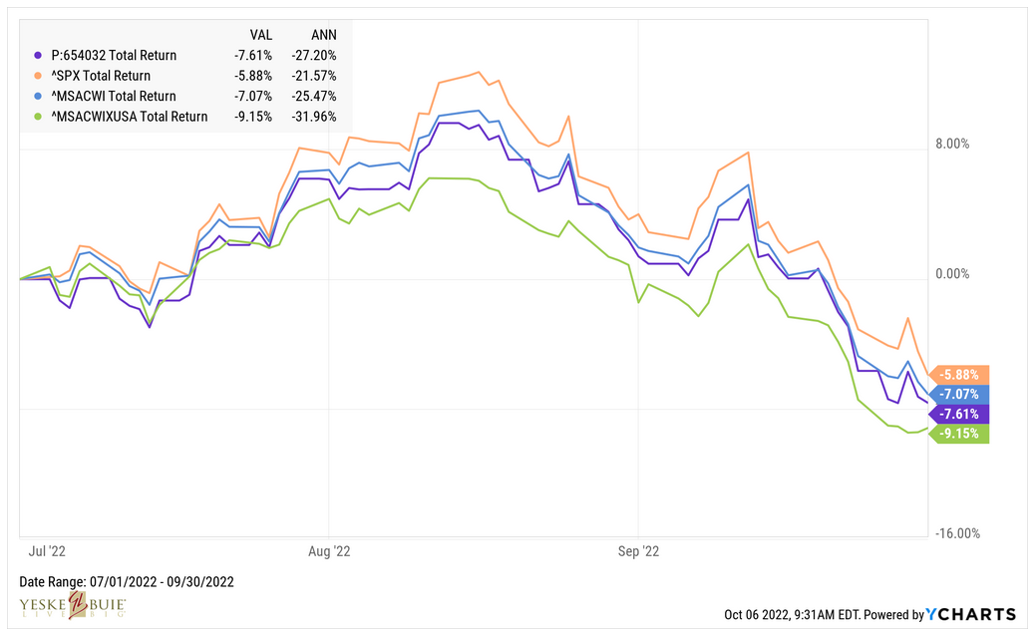
Portfolio Performance: Q3 Through September 30th
Yeske Buie
S&P500
ACWI
ACWX

Slide 3
Portfolio Performance: Q3 Through September 30th

Slide 4
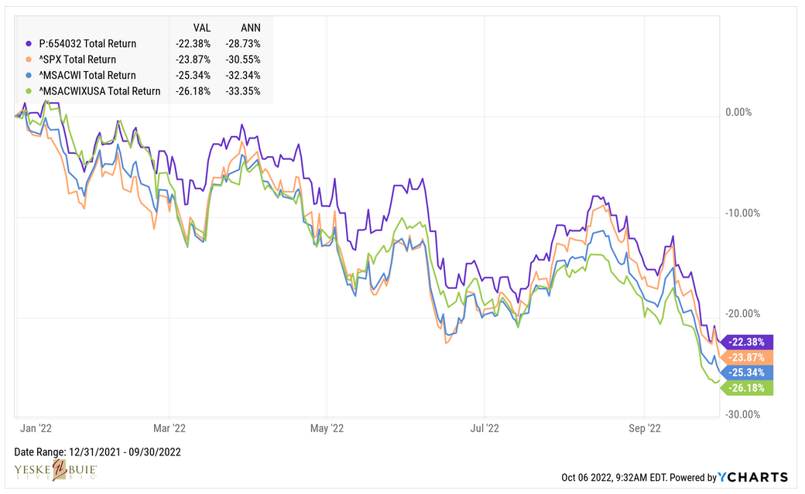
Portfolio Performance: YTD Through September 30th
Yeske Buie
S&P500
ACWI
ACWX

Slide 5
Portfolio Performance: YTD Through September 30th

Slide 6
Value Premium: YTD Through September 30th
Notes:
A dollar earned in the future is worth less than a dollar today
The longer the future, the less the dollar is worth
Growth stock – more of its earnings potential is pushed out further into the future; the higher the rate, the less those earnings are worth
Value stock – more of its earnings potential is focused on the near-term future; higher rates affect those earnings projections less

Slide 7
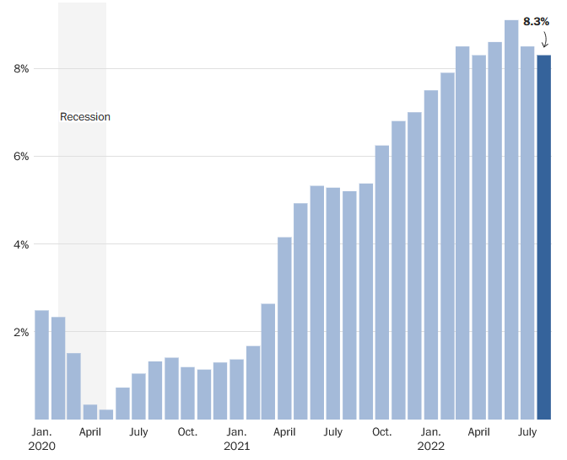
Inflation – Peaked?
Notes:
https://www.washingtonpost.com/business/2022/inflation-charts/ as of 9/13/22

Slide 8
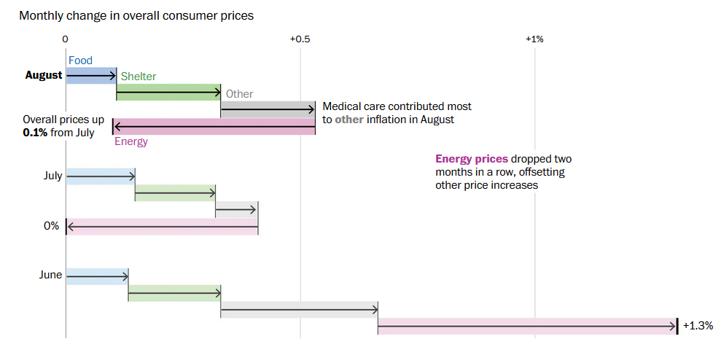
Inflation Drivers
Notes:
https://www.washingtonpost.com/business/2022/inflation-charts/ as of 9/13/22

Slide 9
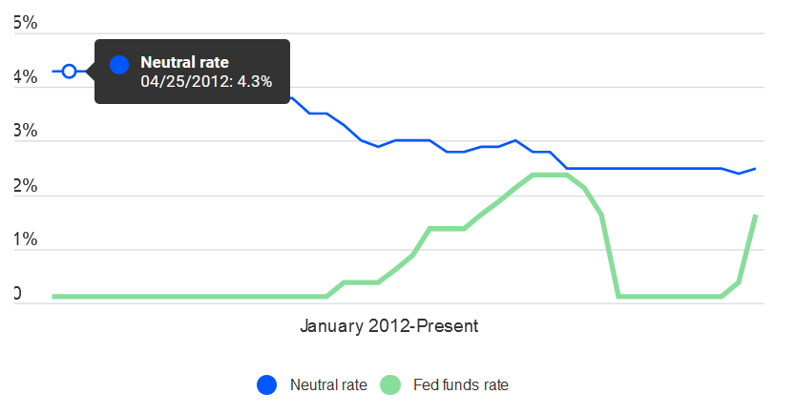
When Will Rates Stop Increasing?
Notes:
https://www.bankrate.com/banking/federal-reserve/what-is-the-fed-neutral-rate-of-interest/
It highlights the main problem: Neutral is up for debate, taking into account a wide variety of factors, including productivity, trend growth, inflation expectations and financial conditions. For that reason, officials often like to say neutral is something that’s inferred rather than known — and it’s just another factor making the Fed’s job hard.
The Fed has certainly learned it can be difficult to get it right since it started publishing its estimates of neutral in January 2012. Back then, neutral was believed to be at 4.3 percent. Officials gradually walked that estimate down — until June 2019, when 2.5 percent officially became the goal post.
Rates in 2018 came close to the Fed’s estimates of neutral. The fed funds rate peaked at 2.25-2.5 percent after the central bank’s ninth and final rate hike in December 2018, but tepid inflation amid the lowest unemployment in half a century tested officials’ perceived belief that rates would neither slow down or speed up the economy once they reached 2.8 percent.
By June 2019, officials would cut interest rates at three straight meetings starting one month later, judging the economy needed more stimulus — not less.
“There were unmistakable signs the economy was slowing,” McBride says. “Sounds a lot like 2022,” but the Fed’s perspective now is different “because we’re talking about inflation that’s at a 40-year high and the urgency to get that down
Projected terminal rate:
4.6% https://www.bloomberg.com/news/articles/2022-09-15/for-fed-the-neutral-rate-is-crucial-and-unknown-quicktake
Some saying fed won’t raise rates in December if inflation trends are encouraging, citing the rising dollar and global financial stability as reasons for the Fed to stop tightening after the November meeting
https://finance.yahoo.com/news/fed-hike-rates-once-more-162451322.html

Slide 10
The Fed and Interest Rates
November 2nd & 3rd
Expected 0.75% rate hike
Fed Funds Rate after hike: 3.75%-4%
December 14th & 15th
Expected 0.50% rate hike
Fed Funds Rate after hike: 4.25%-4.5%

Slide 11
What We’re Watching
Remaining Inflation Readings in 2022
PCE: October 28th, December 1st, and December 23rd
CPI: November 10th, and December 13th
Mid-Term Elections: November 8th
Russia/Ukraine War
Notes:
Europe is the largest importer of natural gas in the world
Imports 80% of gas needs
In 2021, Russia, Germany, the UK, Italy, and France consumed 75% of Europe’s gas
Russia supplied 40% of the EU’s consumption, and those exports have been cut by 75% in response to sanctions
The shortage has been a driver in rising food and energy costs

Slide 12
Thank you!
www.yebu.com

