Slide 1
Interest Rates, Inflation, and Banks – What Now?
Dr. Dave Yeske, CFP® and Yusuf Abugideiri, CFP®

Slide 2
Today’s Agenda
Comparative Performance Review
Labor Market Update
Inflation and Interest Rates
Banking Scare and Asset Protection
Q2 and Beyond: Outlook
1
Notes:
We’re going to tell them what’s been happening in financial markets and how it has affected them/their portfolio
We’re going to talk about some of the economic drivers that have affected performance and that inform our outlook going forward
We’ll address recent events re: banks and share more about why we’re not concerned and also how our Clients’ assets are protected
And then we’ll conclude with our outlook

Slide 3
Big Picture: Cumulative Return Since December 31, 2021
2
Notes:
Kick it to DY, who will take us through these slides
We begin with the big picture, first by showing returns since the end of 2021
2022 was rough for reasons that have been well-documented (Russia/Ukraine war, inflation)
Saw peak inflation last summer, met with four straight increases of 0.75% of fed funds rate (June, July, September, November)
Markets seemed to have appropriately calibrated expectations by the end of Q3, bottomed out as of 9/30/22

Slide 4
Big Picture: Cumulative Return from 1994 to March 31, 2023
3

Slide 5
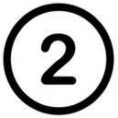
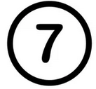
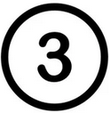
It’s Always Something!
4
Notes:
1. Dot-com meltdown, 2. Great Recession (real estate bubble), 3. Greek Debt Crisis, 4. Debt Ceiling Crisis, 5. China slowdown scare, 6. Global slowdown, Fed rate rises, more tariffs, 7. Covid recession

Slide 6
International Stocks Outpacing US: Q4 2022 & Q1 2023
5
Notes:
What’s been happening since markets bottomed out?
First, we’ll note that from peak to trough (12/31/2021 thru 9/30/2022), we beat the major indices we track (ACWI, ACWX, S&P500) – see notes on slide
Since 9/30, we’re ahead, too (see slide) (not counting int’l, but we’re beating the ACWI, our actual benchmark)
From peak to trough, we beat our benchmarks:
YB: -22.38%
S&P500: -23.87%
ACWI: -25.34%
ACWX: -26.18%
Since markets started recovering:
ACWX: 22.38%
YB/ACWI: 18.13 and 18.06%
S&P500: 15.63

Slide 7
International Stocks Outpacing US: Q4 2022 & Q1 2023
6
Notes:
We can burrow further into the numbers to see the trends
Int’l > US
Size premium on the int’l side only, but close on the US side
Value premium in ¾ quadrants (not US large, but barely)

Slide 8
Bond Market Stabilizing? Q4 2022 & Q1 2023
7
Notes:
Turn to bond market, and over the same time period the story is similar – returns have been great over the past six months
Global core plus: 6.88%
Short term bond: 3.01%
Five year global: 2.17%
One year fixed: 1.99%

Slide 9
Bond Market Stabilizing? Q4 2022 & Q1 2023
As of March 31st | Average Maturity | Yield to Maturity
Five-Year Global Fixed Income | 1.31 | 5.01%
Global Core Plus Fixed Income | 7.41 | 5.66%
One-Year Fixed Income | 0.64 | 4.85%
Short-Term Bond Index | 2.80 | 4.46%
8
Notes:
Benefits of using a fund vs. just buying treasuries: fund managers are actively working w/r/t the yield curve and how it’s evolving. As the yield on the 10-year bond has been decreasing, and shorter term yields have been increasing, managers have been changing the holdings in the funds to have shorter maturities to maximize the yield to maturity.
Average maturities:
Five year global: down from 1.85 just last month
Global core plus: down from 8.97
One year fixed: down from 0.89
*short term bond index figures as of 2/28/2023

Slide 10
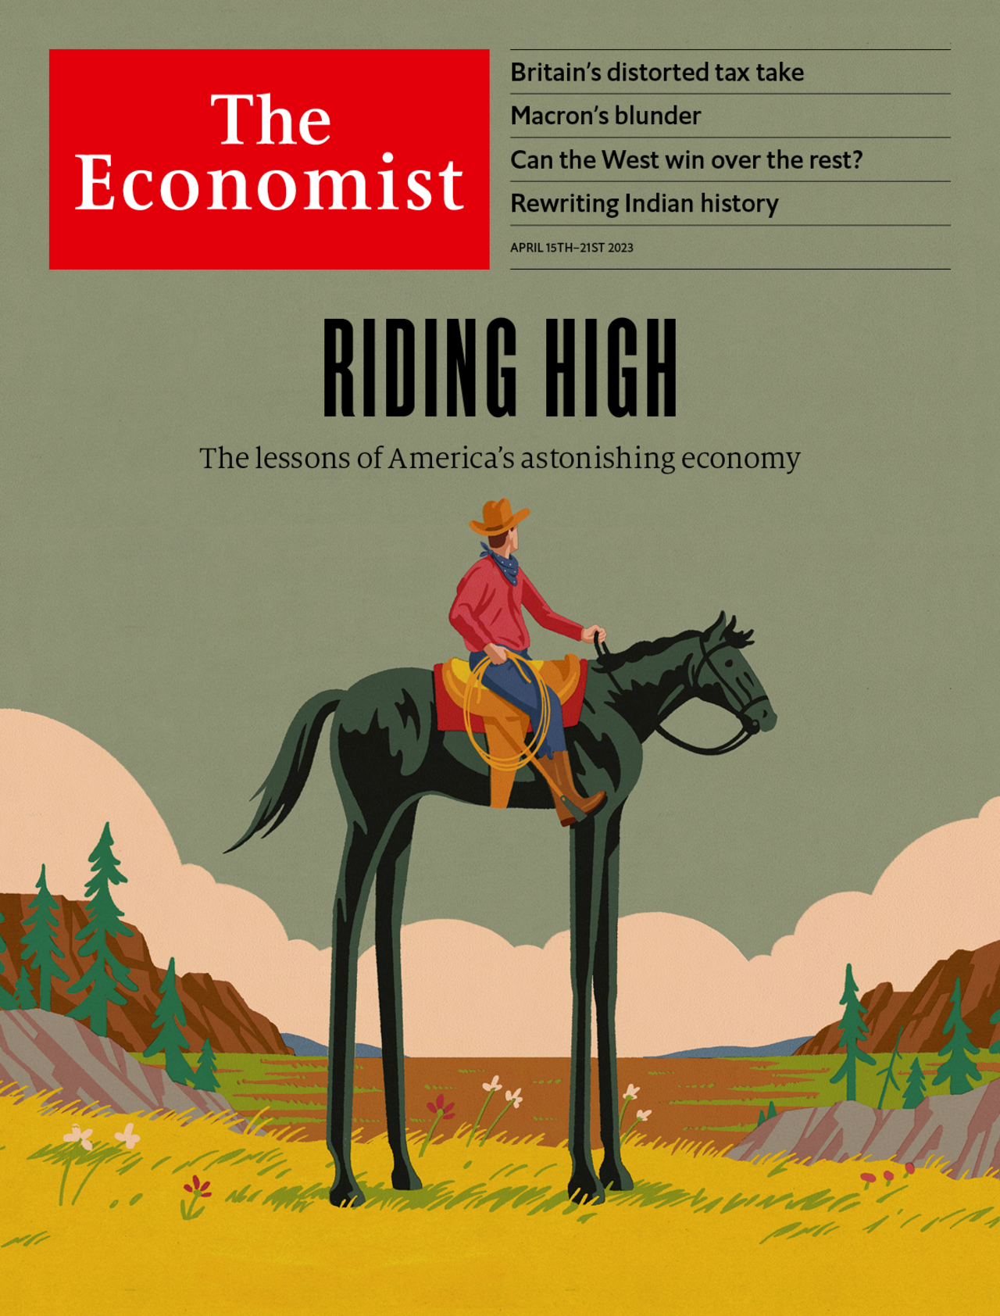
The Lessons of America’s Astonishing Economy
9
Notes:
Article drew a lot of comparisons between 1990 and now
1990, accounted for ¼ of world GDP
That’s still true, even with China growing into a global superpower
58% of the G7’s GDP, relative to 40% in 1990
30% more workers now than in 1990, as compared 10% growth in Europe and Japan
Gonna spend the next few slides talking about GDP and the labor market, with the comparison focusing on our recovery from the two most recent recessions

Slide 11
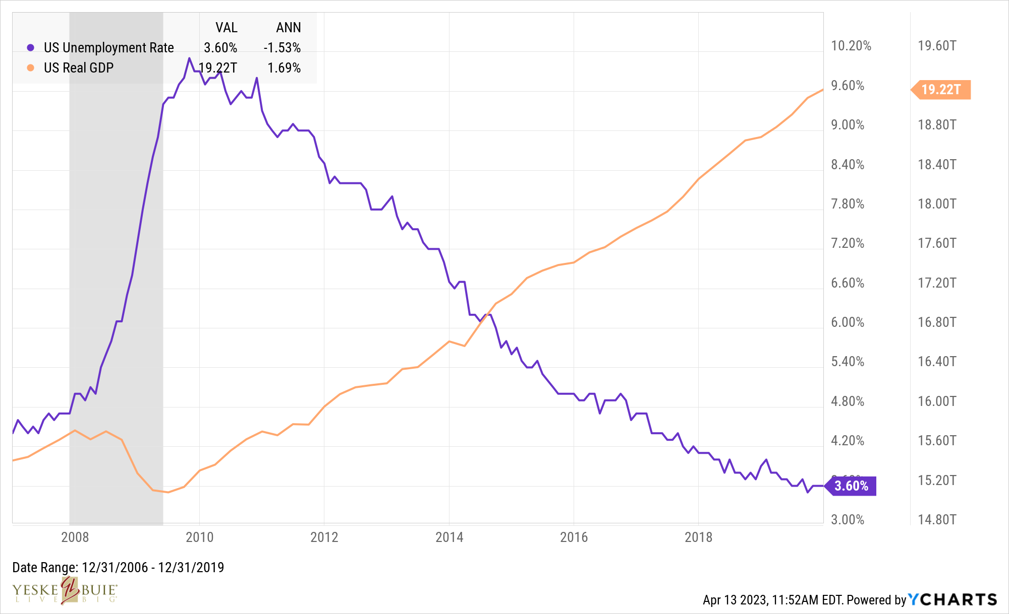
Labor Market Updates
Real GDP
Unemployment Rate
10
Notes:
Took 10 years to make this kind of improvement after the financial crisis
Then we switch to talking about the labor market, because
The fed has a dual mandate, and you can’t navigate a soft landing for the economy by managing the inflation side without being mindful of the labor side
With the big picture in mind, I wanted to tell a story about how well the economy is performing right now, headlines be damned, and why the trends are so encouraging. So I started with a slide illustrating the recovery from the Great Recession
During a stretch that coincided with the longest bull market in US history, real GDP grew by 1.69% (and inflation was MUCH lower over that period)

Slide 12
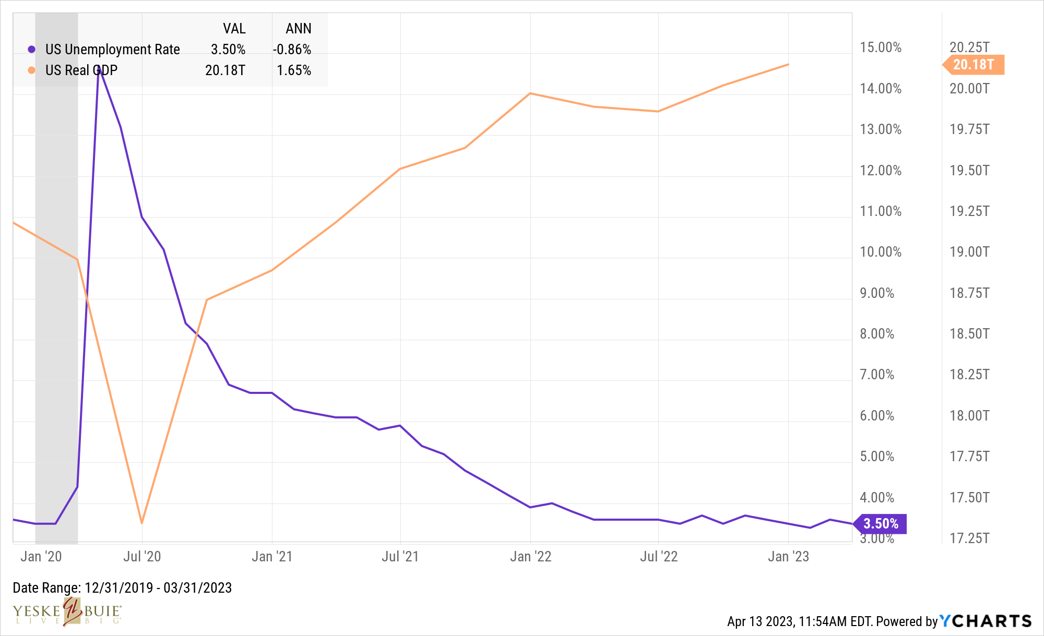
Labor Market Updates
Real GDP
Unemployment Rate
11
Notes:
Fed reserve bank of Atlanta projects Q1 GDP growth to be 2.2% (seasonally adjusted annual rate)
Takeaways:
Average annual growth of almost 10% for two years plus
Inflation adjusted growth in excess of 3% for two years plus
Unemployment hasn’t been this low since 1969

Slide 13
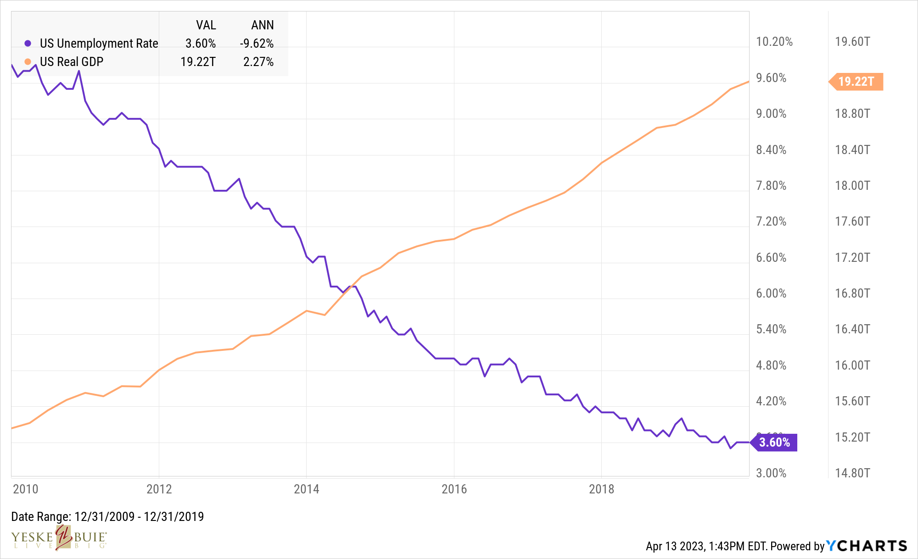
Labor Market Updates
Real GDP
Unemployment Rate
12
Notes:
Took 10 years to make this kind of improvement after the financial crisis

Slide 14
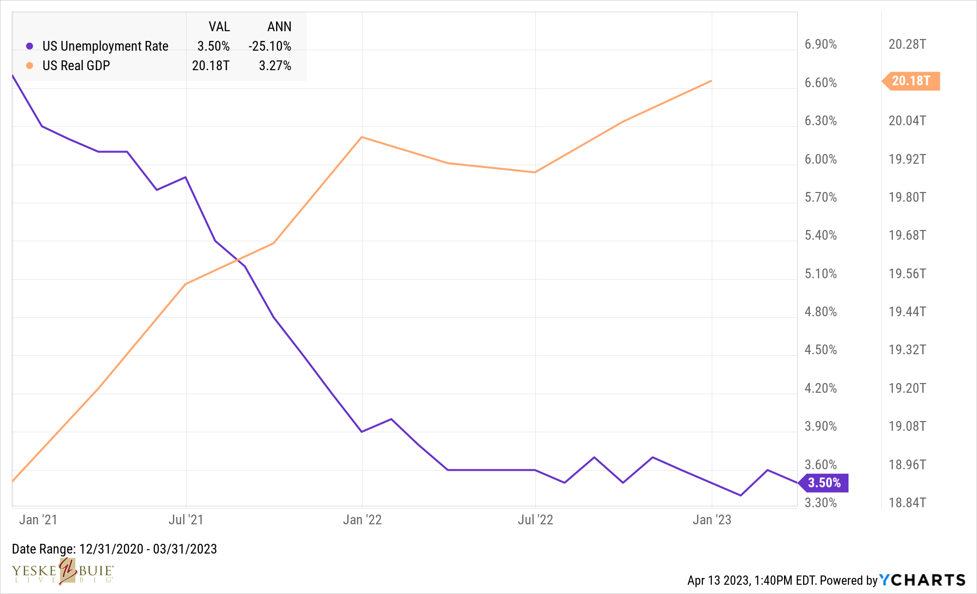
Labor Market Updates
Real GDP
Unemployment Rate
13
Notes:
If we ignore 2020 from a GDP standpoint (GDP was flat, real gdp down 1.5% for that year), here’s growth since beginning of 2021
Although as I write this, I’m leaning towards telling this story: compared to that period that coincided with the longest bull market in US history, real GDP is growing faster by a full 1% in the recovery from the COVID recession relative to the recovery from the Great Recession
And another observation regarding the recoveries from both recessions: beginning with the first full year after each recession, the unemployment rate has decreased by a rate of almost 3x higher in the COVID recovery relative to the Great Recession recovery
Fed reserve bank of Atlanta projects Q1 GDP growth to be 2.2% (seasonally adjusted annual rate)
Takeaways:
Average annual growth of almost 10% for two years plus
Inflation adjusted growth in excess of 3% for two years plus
Unemployment hasn’t been this low since 1969

Slide 15
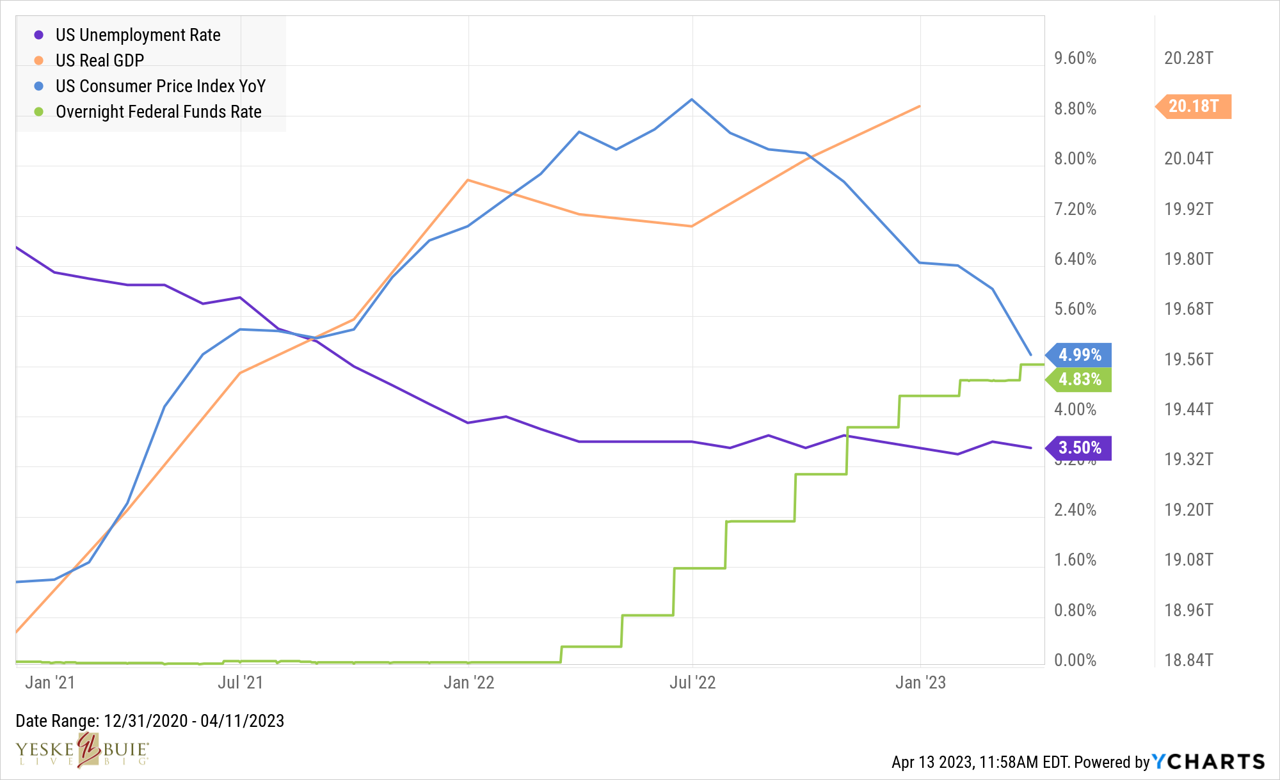
Labor Market Updates
Real GDP
CPI
Fed Funds
Unemployment Rate
14
Notes:
Focusing on period beginning January 2021, as GDP had completely rebounded and real GDP had nearly done so, and here’s what the labor market has looked like
This slide is the argument for the possibility of a soft landing. Thus far, from what we’ve seen, the Fed has been able to wrangle inflation via manipulation of the fed funds rate without constraining growth or killing jobs. AND there are some other trends that are encouraging (softening labor market, wage growth rate decreasing – see notes on the slide)
Takeaways:
What the fed has been doing isn’t NOT working
hasn’t slowed the economy enough to see net losses in jobs
https://www.usnews.com/news/economy/articles/2023-04-10/with-labor-market-easing-inflation-data-becomes-key-focus-for-fed
January: 427k new jobs
Feburary: 326k
March: 236k
Wage growth down from 4.6% to 4.2%
Labor force participation between ages 25 to 54 is same as prepandemic

Slide 16
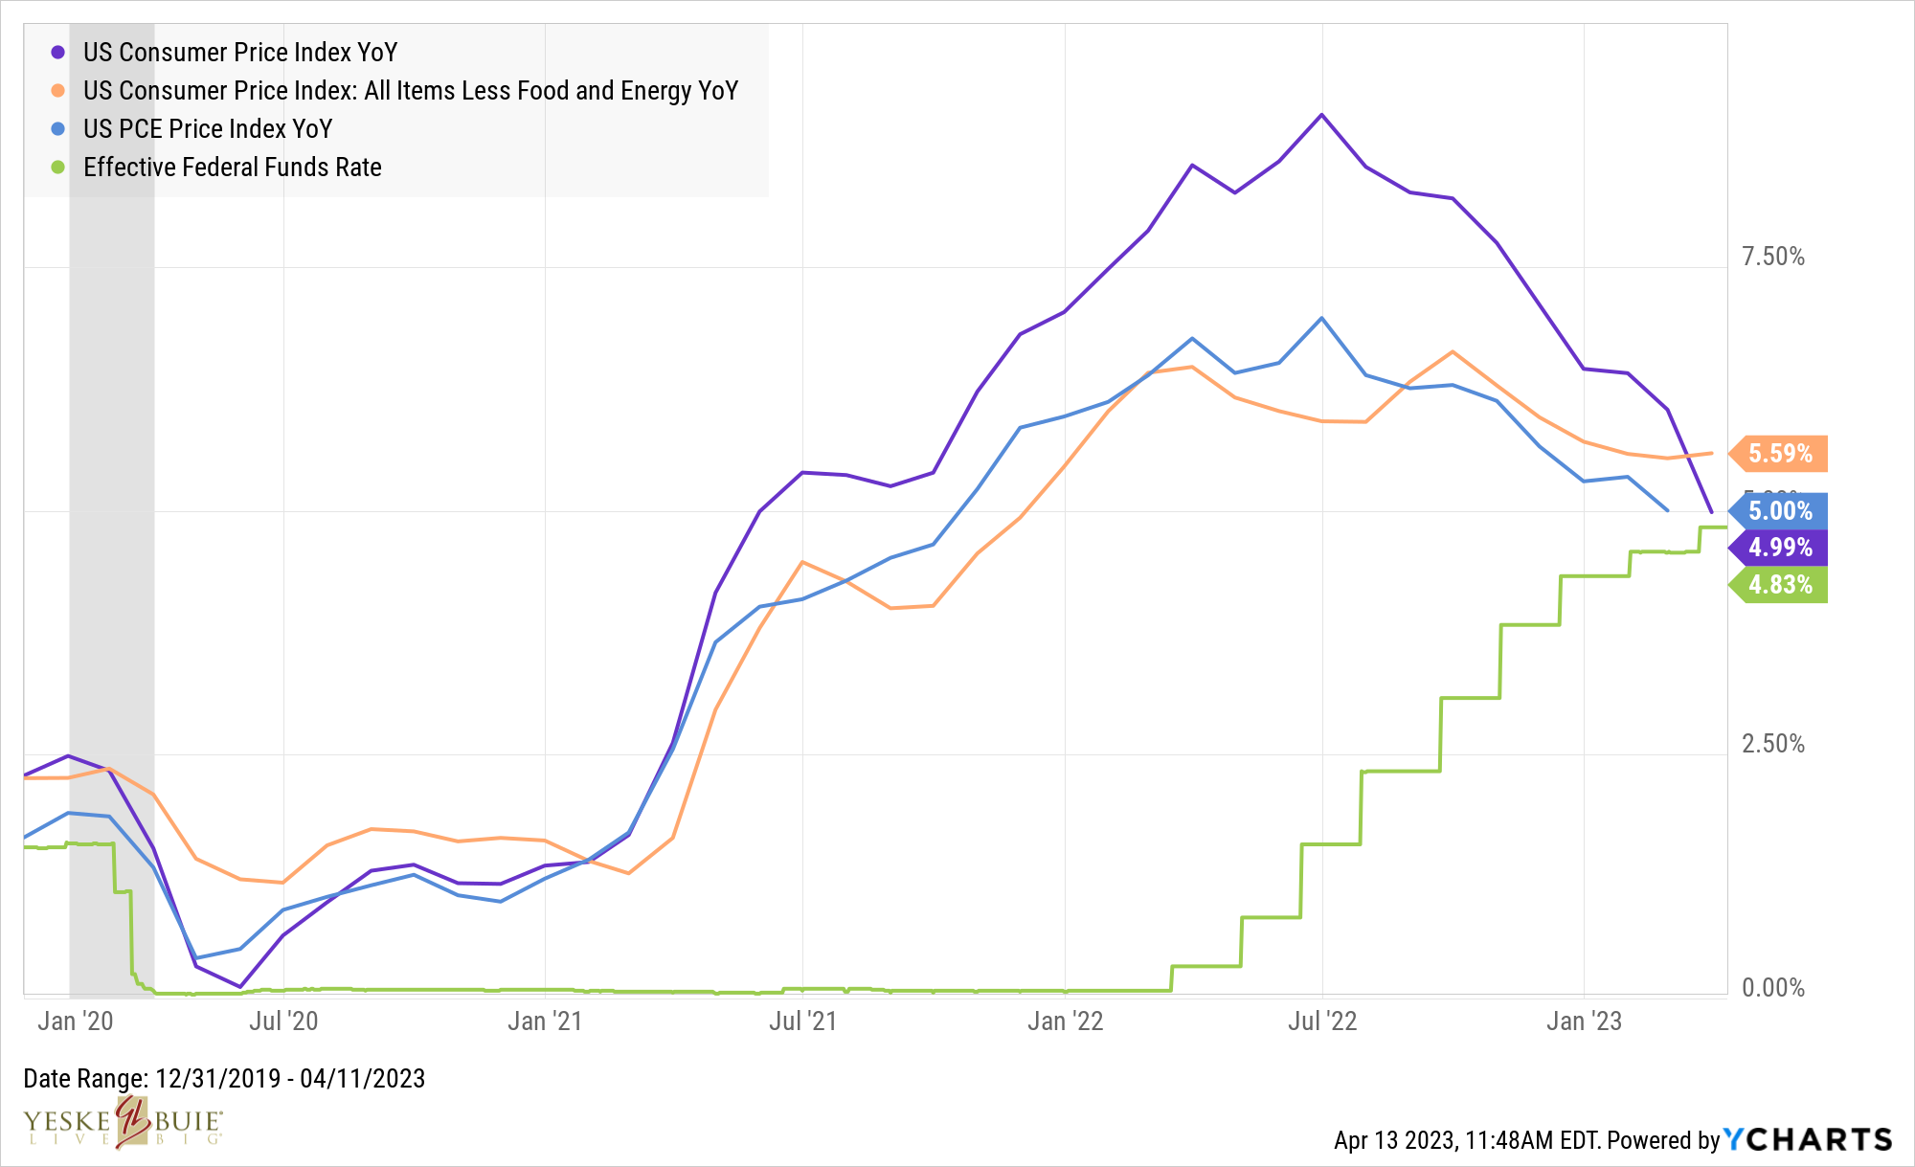
Inflation and Interest Rates
Core CPI
PCE
CPI
Fed Funds
15
Notes:
Here we pivot to our next agenda item
I think we need to point out why the Fed might feel the need to continue to raise rates, which is why I think including all three measures of inflation could make sense – although CPI and PCE continue to fall, we’re seeing stickiness with Core CPI.
CPI Stats:
Nine straight decreases in headline CPI
Next PCE reading is April 28th
Last four readings have been a decrease or flat

Slide 17
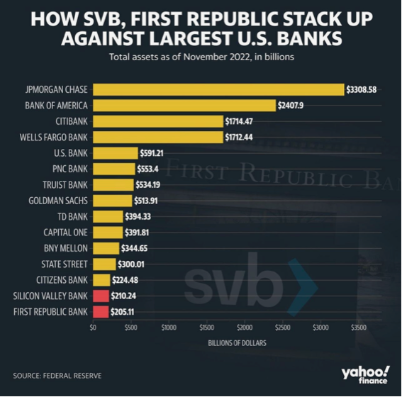
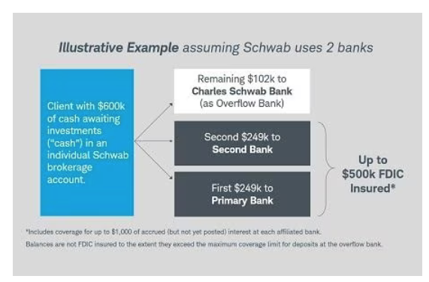
Banks and Asset Protection
16
Notes:
Then a pivot to the bank scare, just to address it since it’s been a big story (but not one that we’re concerned about)
Why we’re not nervous: both SVB and FRB had a ton of exposure to things that had really rough years in 2022 (the tech sector, and crypto), combine those factors with lots of withdrawals coupled with higher interest rates, and it was a recipe for disaster for those two banks (can include Signature Bank, too, just not pictured on the chart)
And of course the reason we’re using the chart is to again put things in perspective; it’s bad when a bank fails, but of the banks to fail, it’s better when it’s the smaller ones. And we don’t think there’s an indication of contagion spreading through the banking sector.
And then how our Clients’ assets are protected
FDIC, advantage of Schwab’s two-bank system
SIPC, additional coverage for investments
Customer protection rule
And we’ll limit it to that and reference the pieces we ran a month ago
Three layers of protection are provided to our Clients via the SEC’s Customer Protection Rule, the Securities Investor Protection Corporation (SIPC) and the Federal Deposit Insurance Corporation (FDIC):
Customer Protection Rule: Mandates that broker/dealers do not commingle Clients’ assets with the broker/dealer’s; in the unlikely event of the broker/dealer’s insolvency, Clients’ investments in stocks and bonds are protected from creditors’ claims.
SIPC: In the unlikely event that a broker/dealer goes out of business, SIPC ensures that Clients keep their assets and facilitates the transfer of their account(s) to another firm, after which the account(s) can be moved to any firm the Client chooses. SIPC insures accounts up to $500,000 per individual, including a maximum of $250,000 for cash.
FDIC: The cash balances in our Clients’ accounts, which are automatically deposited at Schwab Bank via the Bank Sweep feature, are FDIC-insured (up to $250,000 of coverage per individual). Because Schwab uses a two-bank system to protect its Clients, each individual Client has up to $500,000 of FDIC coverage per account – see below:

Slide 18
Outlook
Next Fed Meeting: May 2nd
Expected rate increase: 0.25% - 0.50%
2023 Fed Meeting Calendar:
June 13th
July 25th
September 19th
October 31st
December 12th
17
Notes:
Projections from economists that fed will raise rates between .25% and .5%, perhaps stop raising rates by mid year if inflation continues to trend in the right direction
https://www.washingtonpost.com/business/2023/01/12/cpi-report-december-inflation/

Slide 19
Questions?
Comments?
Thank you!

Slide 20
Phone: (800) 772.1887 • Email: Info@YeBu.com • www.YeBu.com

